Slide 1
Hello world, my name is Ebrahim Hakimuddin Tayabali and this is my submission for CS50P’s Final Project.

Slide 2
My Project is a Flashcards app. I am from Dar-es-salaam, Tanzania.

Slide 3
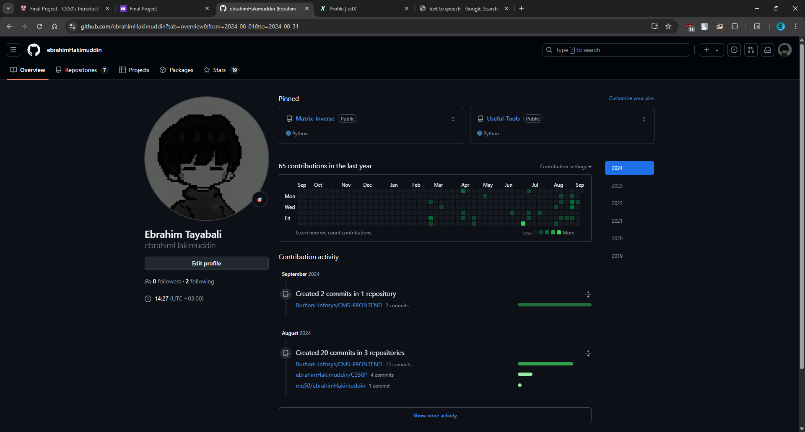
My Github Username

Slide 4
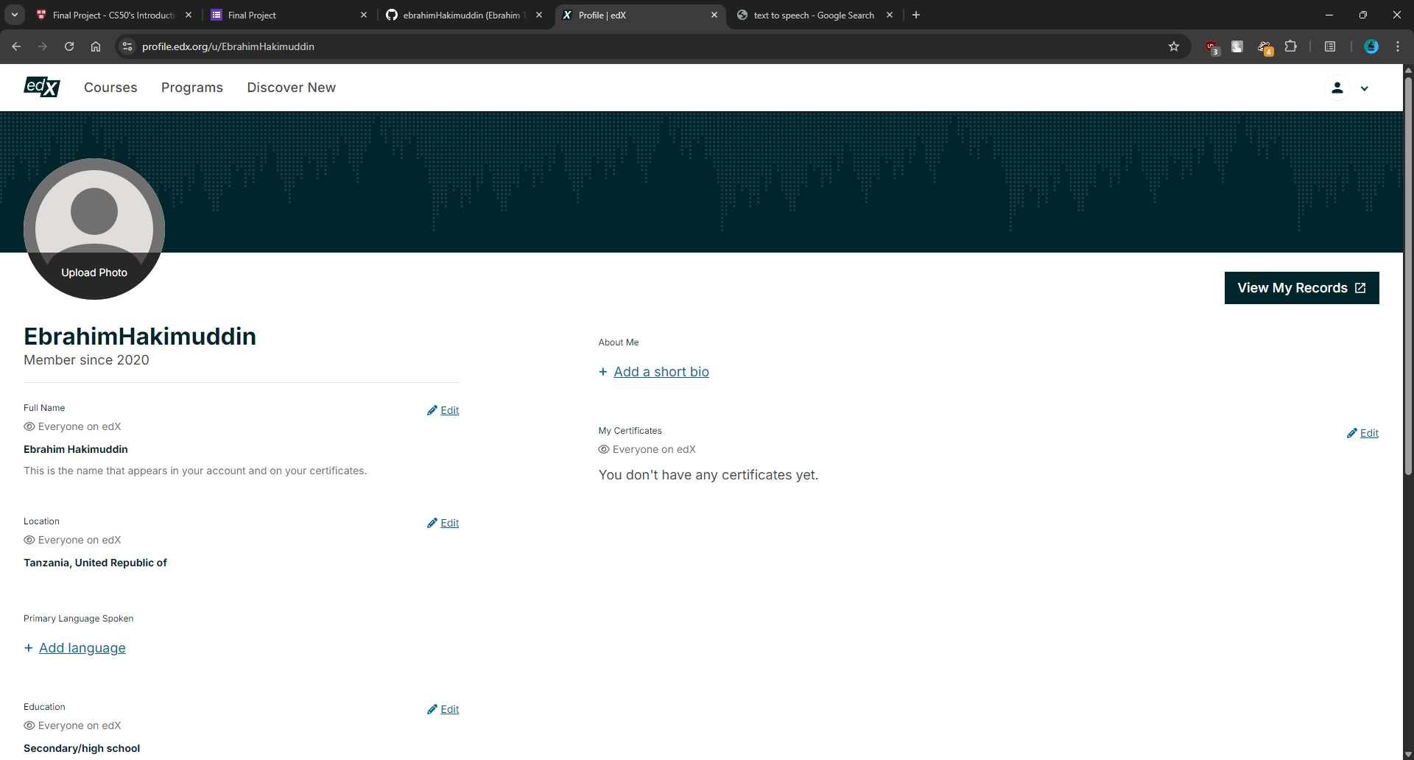
My EDX Username

Slide 5
This video was recorded on 8th September 2024.

Slide 6
My project has two viewing options, the Terminal view and the Tkinter/GUI view

Slide 7
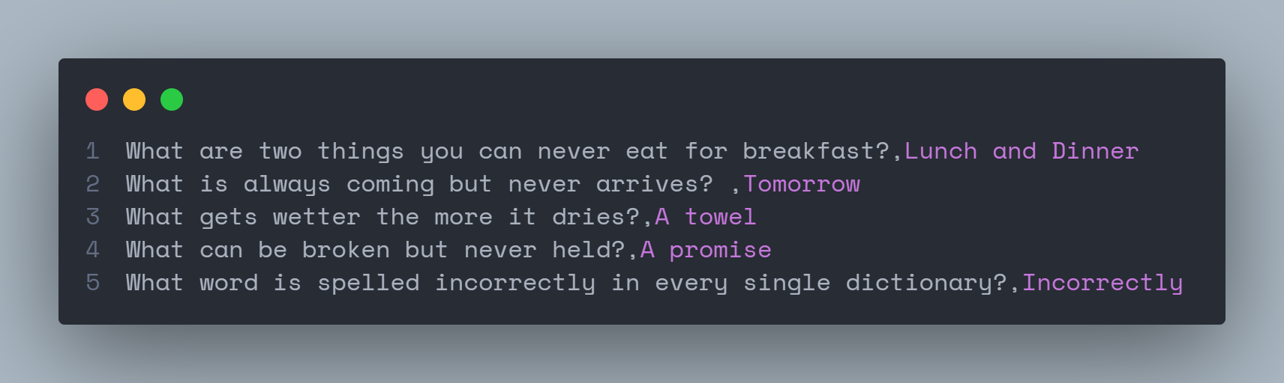
The project accepts a CSV file with a question separated by a comma and then the answer to that question as shown below

Slide 8
Both views can either accept a command-line file input or will prompt the user for an input, either in the terminal or in the GUI as will be demonstrated next.

Slide 9
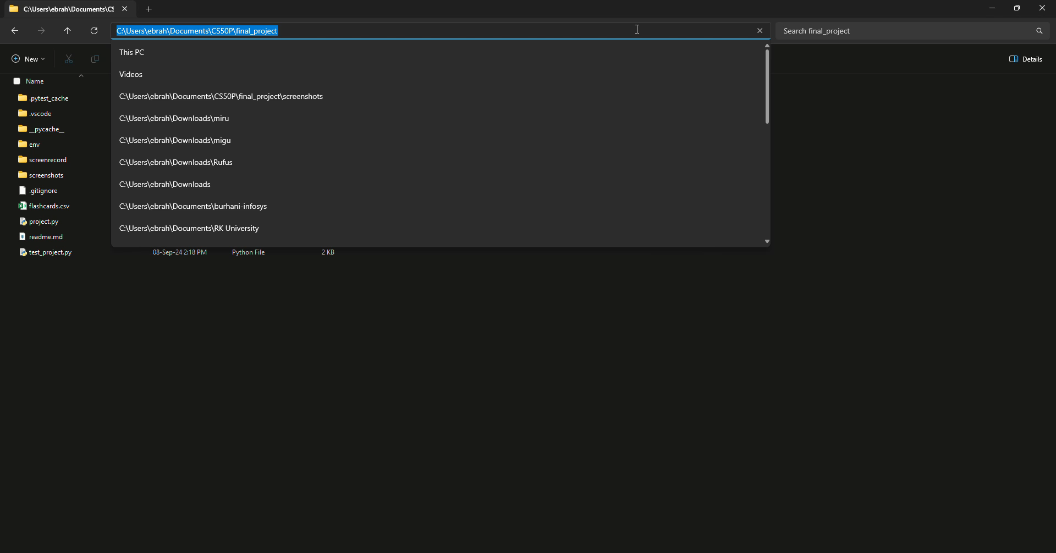
Providing the CSV file:

Slide 10
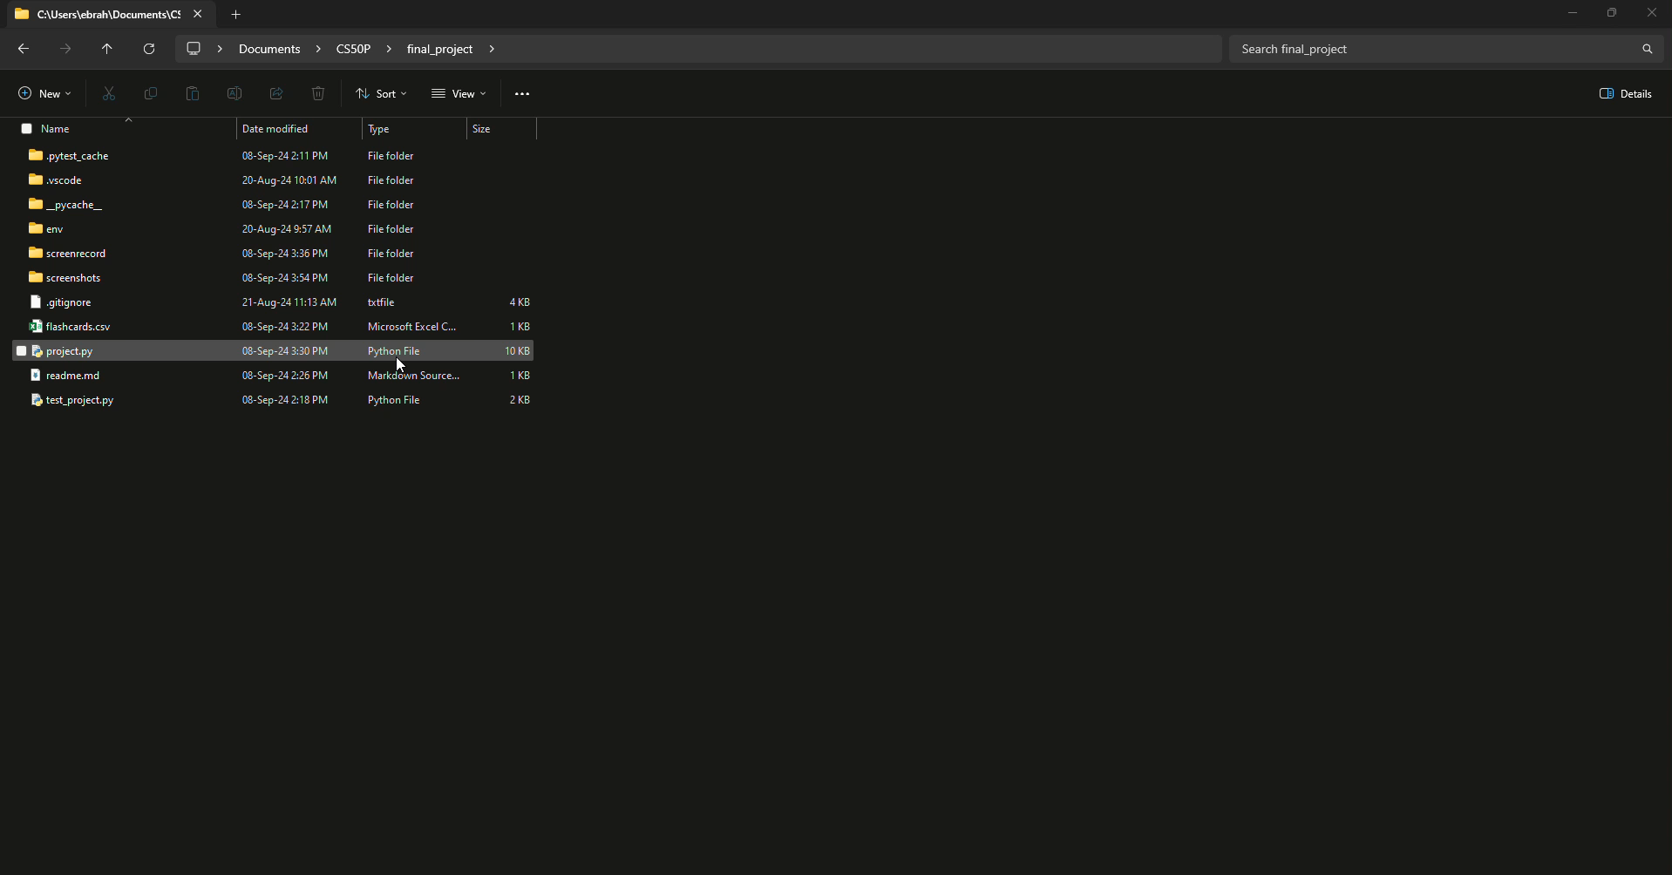
Demonstration Of The GUI view:

Slide 11

Demonstration Of The Terminal view:

